Slide 1
A MAJOR PROJECT
On
NATURAL LANGUAGE TO IOT CODE GENERATOR:
A Generative AI Framework for Automated ESP32 Prototyping
BACHELOR OF TECHNOLOGY
IN
CSE- AI & ML
BY
S. SRI VARSHITHA – 22VE1A6655
K. MAHESH – 22VE1A6622
P. MANOJ – 22VE1A6648
M. YUVAN YADAV – 22VE1A6631
Under the Guidance of
Mrs. G. APARNA
ACADEMIC YEAR: (2025-26)

Slide 2

CONTENTS
Abstract
Introduction
Problem Statement
Objectives
Literature Review
Proposed Methodology
System Architecture
Implementation Details
Results and Analysis
Applications and Advantages
Conclusion and Future Scope
References

Slide 3
Abstract
The Natural Language to IoT Code Generator project enables users to build IoT prototypes simply by describing their ideas in plain English.
It uses Generative AI and Large Language Models (LLMs) to convert natural language instructions into Arduino-compatible ESP32 code.
The system automatically identifies sensors, actuators, and required connections to generate ready-to-deploy code with wiring guidance.
It supports common IoT applications such as smart irrigation, environmental monitoring, and home automation.
Experimental evaluation compares AI-generated code vs manually written code in terms of correctness, execution efficiency, and user-friendliness.
This work aims to democratize IoT development by enabling non-programmers to prototype intelligent systems quickly using natural language.

Slide 4
Introduction
The Internet of Things (IoT) is changing industries like agriculture, healthcare, and smart homes through automation and real-time monitoring.
However, building IoT systems requires programming skills, circuit knowledge, and hardware setup experience.
This creates challenges for beginners and non-technical users.
Although platforms like Arduino IDE and Node-RED help simplify development, they still require manual coding and configuration.
With advancements in Generative AI, it is now possible to generate code automatically from natural language instructions.
Our project, Natural Language to IoT Code Generator, converts plain English commands into ready-to-use ESP32 code with wiring instructions, making IoT development easier and faster.

Slide 5
Problem Statement
Building functional IoT prototypes requires programming skills, hardware knowledge, and circuit design expertise, which many non-engineers lack.
Translating real-world ideas into working IoT solutions is time-consuming and error-prone for users without a technical background.
Existing tools like Arduino IDE, Node-RED, or Blynk simplify coding but still demand manual setup and technical intervention.
There is no user-friendly system that allows natural language input to generate ESP32-compatible code with wiring instructions directly.
This limitation prevents rapid prototyping, restricts the adoption of IoT technology among non-technical users, and hinders innovation.

Slide 6
Objectives
AI-Powered IoT Code Generation: Develop a generative AI framework that converts natural language IoT tasks into executable ESP32 Arduino code with automatic wiring instructions.
Smart Validation & Application Support: Support core IoT functions like sensing, actuation, data logging, and alerts, while validating AI-generated code on real ESP32 hardware for accuracy and reliability.
User-Centric Innovation: Empower non-technical users to rapidly prototype IoT systems, simplifying development and promoting faster IoT adoption.

Slide 7
Literature Survey
S.No | Paper Title | Author(s) | Journal/Conference | Algorithm Used | Results Obtained | Evaluation Parameters Considered | Comments
1 | Integrating Large Language Models with Internet of Things Applications | Zong, M. et al. | Discover IoT (Springer), 2025 | LLM (GPT), Macroprogramming | Achieves 94.9% DDoS detection; efficient macroprogramming and sensor data processing | Detection accuracy, reliability, usability | Demonstrates NL-to-IoT-code, advanced macroprogramming ​
2 | Programming Embedded IoT Applications in Natural Language | Wang, X. et al. | ACM, 2024 | LLM-based methods | Converts NL to IoT code, simplifies development | Code generation quality, usability, development time | Validates LLM-driven code synthesis for IoT ​

Slide 8
Literature Survey
S.No. | Paper Title | Author(s) | Journal/Conference | Algorithm Used | Results Obtained | Evaluation Parameters Considered | Comments
3 | Automated IoT Platform Using Large Language Models | Cheng, Y. et al. | IEEE, 2024 | LLM, AutoIoT | Automates IoT app/code generation from user requests | Code correctness, automation effectiveness | Custom LLM-generated deployment for IoT ​
4 | ChatIoT: Zero-code Generation of Trigger-action Based IoT Applications | Patel, A. et al. | ACM, 2025 | LLMs (ChatGPT, etc.), TAP | NL-driven prototyping, zero-code IoT solutions | Usability, correctness, deployment speed | Enables NL-to-IoT workflows ​
5 | AutoIOT: LLM-Driven Automated Natural Language Programming for AIoT | Shen, L. et al. | arXiv, 2025 | LLM-based synthesis | NL-to-AIoT interpretable programs, matches manual | Synthesis quality, explainability, satisfaction | Strong privacy, explainability, and NL-to-code ​
6 | Generative Language Model Technology Integrated into an IoT Device for the Development of a Voice Assistant | Ricardo Yauri, et al. | WSEAS Transactions on Computers, 2024 | Generative LLM, ChatGPT integration | Real-time ChatGPT-based IoT device with ESP32 | NL processing, speech synthesis, system usability | Real-time, scalable NL interface on ESP32 ​

Slide 9
Literature Survey
S.No. | Paper Title | Author(s) | Journal/Conference | Algorithm Used | Results Obtained | Evaluation Parameters Considered | Comments
7 | Portable Gemini Terminal Using ESP32 | Reddy, P.S.K. et al. | IJREISS, 2025 | Gemini API, Python, ESP32 | Voice-controlled Gemini API on ESP32 | NL-to-query, integration, performance | Real-time command-to-action ESP32 interface ​
8 | How to Code Arduino and ESP32 with AI? | Gupta, R. et al. | Pleasedontcode.com, 2024 | AI code gen, DSL | Automatic sketch/code from user specs, ESP32 | Coding efficiency, output correctness | Covers NLP/AI code workflows for ESP32/Arduino ​
9 | A smart energy monitoring system using ESP32 | El-Khozondar, H.J. et al. | Sci. Direct, 2024 | Data analytics, ESP32 | ESP32 Arduino energy monitoring/control | Arduino code accuracy, IoT performance | Includes auto-generated ESP32 code for sensors ​
10 | Generative AI in Software Engineering: Revolutionizing Coding Practices | Yilmaz, A. et al. | IJCESEN, 2025 | Generative AI, LLMs | Studies GenAI for code and IoT | Coding efficiency, code quality | Evaluates practical value of GenAI for IoT code

Slide 10
Proposed Model
The system takes natural language input from the user describing the desired IoT functionality (e.g., “Turn on the fan when room temperature exceeds 30°C”).
A Large Language Model (LLM) parses the input to extract intent, devices, sensors, and actions required for the task.
The system identifies the appropriate domain (e.g., Temperature Monitoring or Smart Agriculture).
Predefined ESP32 templates and sensor/actuator libraries are selected based on the detected domain.
Arduino-compatible ESP32 code and detailed wiring instructions are automatically generated.
The generated code is uploaded and validated on real ESP32 hardware to demonstrate multi-domain functionality.

Slide 11
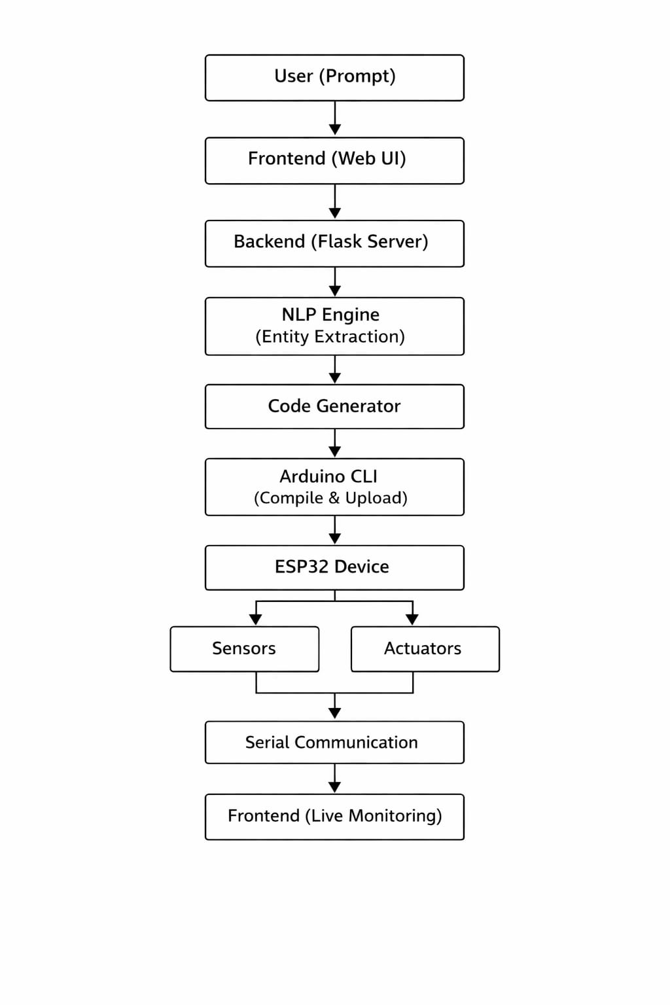
System Architecture

Slide 12
System Architecture
User Input Module: Accepts natural language commands describing the desired IoT system behaviour.
Frontend Web Interface: Provides a browser-based platform to capture user input and display generated outputs.
Flask Backend Server: Handles API requests and coordinates communication between frontend and processing modules.
NLP & Intent Detection Module: Extracts domain, sensor, actuator, condition, and threshold information from the input command.
Domain Identification Component: Classifies the command into a specific IoT domain, such as Temperature or Agriculture.

Slide 13
System Architecture
Code Generation Module: Generates executable ESP32 Arduino code using domain-specific templates.
Wiring Instruction Generator: Produces accurate GPIO mappings and hardware connection details for the selected components.
Components List Generator: Identifies and lists required hardware components based on detected domain and intent.
ESP32 Deployment Layer: Uploads and executes the generated Arduino code on the ESP32 microcontroller.
Sensor Layer: Captures environmental data such as temperature or soil moisture for system decision-making.
Actuator Layer: Performs physical actions such as activating LEDs, relays, or pumps based on control logic.

Slide 14
Implementation Details
Tools & Technologies Used
Frontend: HTML, CSS, JavaScript
Backend: Python, Flask
NLP Processing: Rule-based Intent Detection
IoT Platform: ESP32 Microcontroller
Programming Environment: Arduino IDE
Sensors: DHT11 (Temperature), Soil Moisture Sensor
Actuators: LED, Relay Module, Water Pump
Dataset / Input Source: No external dataset required

Slide 15
Implementation Details
Step-by-Step Development Process
Designed web interface for natural language input
Developed Flask backend API for request handling
Implemented NLP module for intent and domain extraction
Created domain-based ESP32 code templates
Generated wiring instructions and components list dynamically
Tested generated code on ESP32 hardware prototype
Validated system using temperature and agriculture use cases

Slide 16
Results and Analysis

Slide 17
Applications
Smart Agriculture → Automated irrigation & crop monitoring
Smart Home → Control appliances using natural language
Environmental Monitoring → Air quality & temperature tracking
Healthcare → Patient monitoring & alert systems
Education → Easy IoT learning for students
Industrial Automation → Process monitoring & control
Advantages
No coding required (natural language based)
Saves time and reduces development effort
Minimizes errors with automated code generation
Provides both code and wiring instructions
Easy to use for non-technical users
Scalable for multiple IoT applications

Slide 18
Conclusion
Successfully developed a Natural Language to IoT Code Generator for ESP32-based systems.
Enabled automatic generation of executable Arduino code, wiring instructions, and components list from plain English input.
Implemented multi-domain support including Temperature Monitoring and Smart Agriculture.
Reduced development time and minimized manual coding errors in IoT prototyping.
Validated the system through real-time hardware execution using ESP32 and sensors.
Demonstrated a scalable framework that can be extended to additional IoT domains in the future.

Slide 19
Future Scope
Extend the system to support additional domains such as Smart Home, Industrial Safety, and Healthcare monitoring.
Integrate advanced AI/LLM-based NLP models for more accurate and flexible natural language understanding.
Add cloud integration and MQTT support for remote monitoring and control.
Develop a mobile application for real-time IoT code generation and deployment.
Implement drag-and-drop visual wiring diagrams for improved user experience.
Deploy the system as a scalable no-code IoT platform for educational institutions and startups.

Slide 20
References
[1] Z. Gui, H. Li, and T. Wang, “Natural language interfaces for IoT systems: Design and implementation using Web of Things,” IEEE Internet of Things Journal, vol. 10, no. 12, pp. 10452–10464, 2023.
[2] S. Wang, Y. Chen, and M. Liu, “Survey of techniques for converting natural language into code using transformer models,” IEEE Access, vol. 11, pp. 88421–88438, 2023.
[3] L. Shen, Y. Zhao, and K. Huang, “Lightweight language models for IoT code generation in edge environments,” IEEE Transactions on Emerging Topics in Computing, vol. 12, no. 2, pp. 678–690, 2024.
[4] R. Patel and K. Shah, “Low-code IoT automation frameworks: Design and performance evaluation,” IEEE Access, vol. 12, pp. 10234–10249, 2024.
[5] S. Haug, M. Fischer, and T. Braun, “Automated validation techniques for microcontroller-based IoT applications,” IEEE Embedded Systems Letters, vol. 17, no. 1, pp. 21–25, 2025.

Slide 21
[6] Y. Zhang, X. Liu, and D. Chen, “Structured firmware generation for resource-constrained embedded systems,” IEEE Internet of Things Journal, vol. 11, no. 5, pp. 4210–4223, 2024.
[7] T. Nguyen and A. Park, “Safety-aware code generation for embedded IoT devices,” IEEE Transactions on Software Engineering, early access, 2024.
[8] M. Lee, K. Choi, and P. Roy, “Evaluation of automated code generation techniques for embedded systems,” IEEE Systems Journal, vol. 18, no. 2, pp. 1650–1661, 2024.
[9] F. Hassan and R. Ibrahim, “Edge-based IoT automation using structured command interpretation,” IEEE Internet of Things Magazine, vol. 7, no. 1, pp. 34–40, 2024.
[10] K. Verma and P. Singh, “Rule-based approaches for embedded firmware generation in IoT systems,” IEEE Transactions on Industrial Informatics, vol. 21, no. 3, pp. 1895–1904, 2025.
[11] M. Hassan, R. Ali, and J. Kim, “Lightweight natural language interfaces for edge IoT control systems,” IEEE Internet of Things Journal, vol. 11, no. 14, pp. 12876–12889, 2024.
[12] P. R. Deshmukh and L. Wang, “Template-oriented firmware generation for low-power microcontrollers,” IEEE Transactions on Industrial Informatics, vol. 20, no. 6, pp. 4890–4901, 2024.

Slide 22
[13] K. Yamamoto and S. Gupta, “Deterministic parsing models for embedded code synthesis,” IEEE Embedded Systems Letters, vol. 17, no. 2, pp. 55–59, 2025.
[14] T. Brown and H. Zhao, “Comparison of rule-based and transformer-based code generation for IoT applications,” IEEE Systems Journal, vol. 19, no. 1, pp. 210–221, 2025.
[15] E. Martínez, J. Lopez, and A. Singh, “Hardware-aware natural language programming frameworks for IoT automation,” IEEE Access, vol. 13, pp. 33412–33425, 2025.
[16] A. R. Mehta and S. Kulkarni, “Edge-intelligent IoT automation using lightweight embedded models,” IEEE Internet of Things Journal, vol. 11, no. 9, pp. 7421–7433, 2024.
[17] H. Liu, Y. Park, and M. Chen, “Automated firmware synthesis techniques for embedded systems,” IEEE Transactions on Industrial Informatics, vol. 20, no. 4, pp. 3102–3113, 2024.
[18] J. Alvarez and T. Nguyen, “Hardware validation strategies for reliable IoT firmware deployment,” IEEE Embedded Systems Letters, vol. 17, no. 2, pp. 45–49, 2025.
[19] S. Gupta and R. Sharma, “Efficient IoT code generation using domain-specific languages,” IEEE Access, vol. 12, pp. 55213–55228, 2024.
[20] D. Jurafsky and J. H. Martin, Speech and Language Processing, 3rd ed., draft, 2023.

Slide 23
THANK YOU

Slide 24
Queries ??

